Slide 1
Software Design and Architecture
Architecture Characteristics Defined

Slide 2
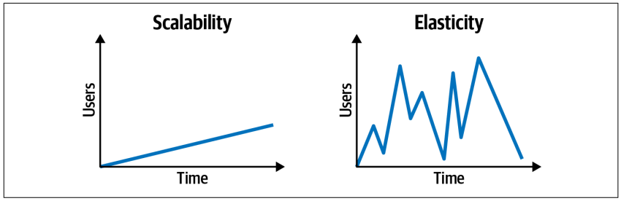
Scalability and Elasticity
Scalability: Ability to remain responsive as user load gradually increases over time (ability to handle a large number of concurrent users without serious performance degradation)
Elasticity: Ability to remain responsive during significantly high instantaneous spike in user load

Slide 3
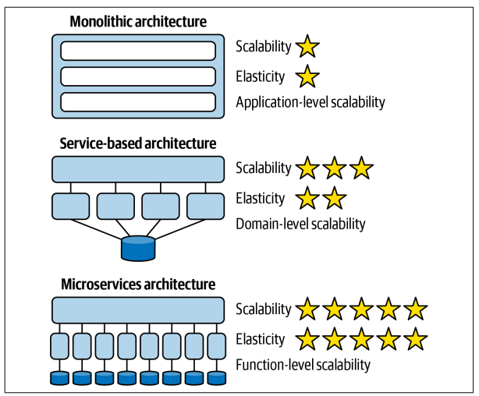
Impact of Scalability and Elasticity on Modularity

Slide 4
Architectural Characteristics
Scalability
Elasticity
Modularity
….ilities
Requirements specify what the application should do
Architectural characteristics specify operational and design criteria for success, how to implement the requirements, and why certain choices were made

Slide 5
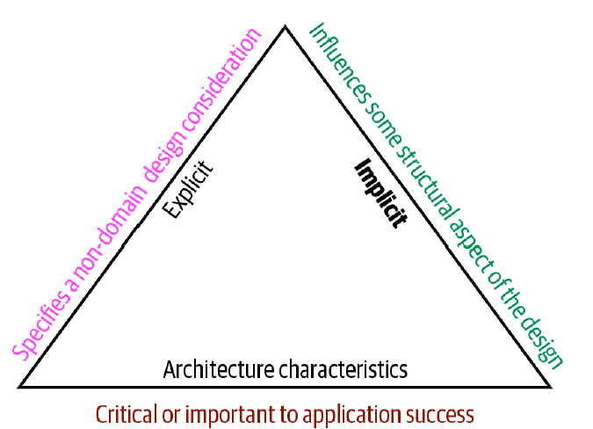
Characteristics are nondomain design considerations
We must support
thousands of users during lunch period ! (Elasticity)

Slide 6
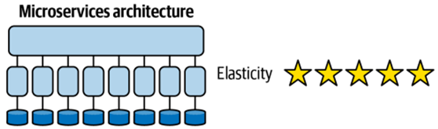
Characteristics influence architectural structure

Slide 7
Limit characteristics to prevent overengineering
Overengineering supports too many architectural characteristics and complicates the overall design to little or no benefit
Knowing which architectural characteristics are critical or important to application success acts as a filtering tool

Slide 8
Consider explicit and implicit capabilities
Explicit—stated clearly
Implicit—assumed based on context or other knowledge
We must support
thousands of users during lunch period ! (Elasticity)
We need to
protect the
privacy of users.

Slide 9
Consider explicit and implicit capabilities
Explicit—stated clearly
Implicit—assumed based on context or other knowledge
Implicit ACs (such as availability, reliability, and security) rarely appear in requirements, yet they’re necessary for project success.
Explicit ACs appear in requirements documents

Slide 10
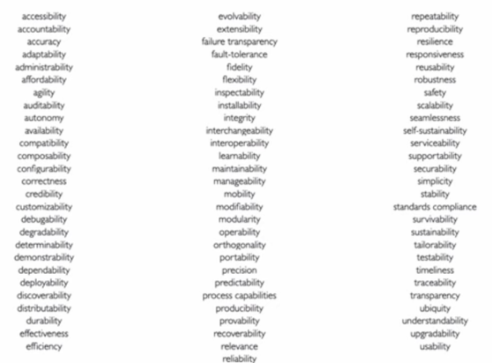
Some Architecture Characteristics

Slide 11
Categories of Architecture Characteristics
Operational architecture characteristics : How the system behaves during runtime
Process architecture characteristics : The ease in which system can be created and modified
Structural Architecture Characteristics : How the logical and physical parts of the system are designed and how they interact with each other
Cross-Cutting Architecture Characteristics : cover characteristics fall outside the first three such as usability, privacy, and security

Slide 12
Operational architecture characteristics
Responsiveness: The amount of time to take to get data to users
Availability: The amount of uptime of the system
Recoverability: The ability of the system to start where it left off in the event of a system crash
Scalability: The ability of the system to handle increased user loads with consistent performance
Data Integrity : The data across the system is correct and there is no data loss in the system
Fault Tolerance: When fatal errors occur, other parts of the system continue to function

Slide 13
Process architecture characteristics
Maintainability: The ease at which code can be located and modified
Testability: The ease and completeness of testing
Deployability: How easy and efficient it is to deploy the software system
Extensibility: The ease in which the structure of the system can be extended for new functionality
Adapability: The ease in which the structure of the system can adapt to change in the environment and functionality

Slide 14
Structural architecture characteristics
Modularity: The degree to which the system is composed of discrete components
Portability: The ability for the system to run on multiple platforms
Interoperability: The ability of the system to interface and interact with other systems
Abstraction: The level at which parts of the system are isolated from other parts of the system
Workflow : The ability of the system to manage communication of multiple components within a business process

Slide 15
Cross-Cutting architecture characteristics
Security : How secure the system is, holistically
Privacy : How well the system hides and encrypts transactions so that internal employees like data operators, architects, and developers cannot see them
Usability : How easy is it for users to achieve their goals. Is training required? Usability requirements need to be treated as seriously as any other architectural issue.
Accessibility : How easy is it for all your users to access the system, including those with disabilities, like colorblindness or hearing loss
Authentication/authorization : How well the system ensures users are who they say they are and makes sure they can access only certain functions within the application (by use case, subsystem, web page, business rule, field level, etc.)
Legal : How well the system complies with local laws about data protection and about how the application should be built or deployed

Slide 16
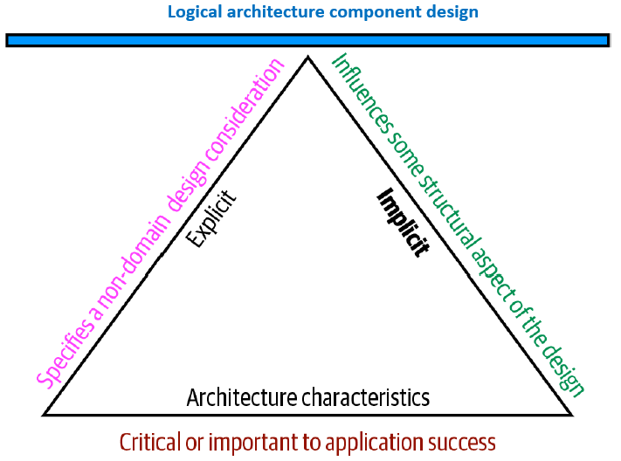
Structural considerations for an architecture
Architectural characteristics
Logical architecture components

Slide 17
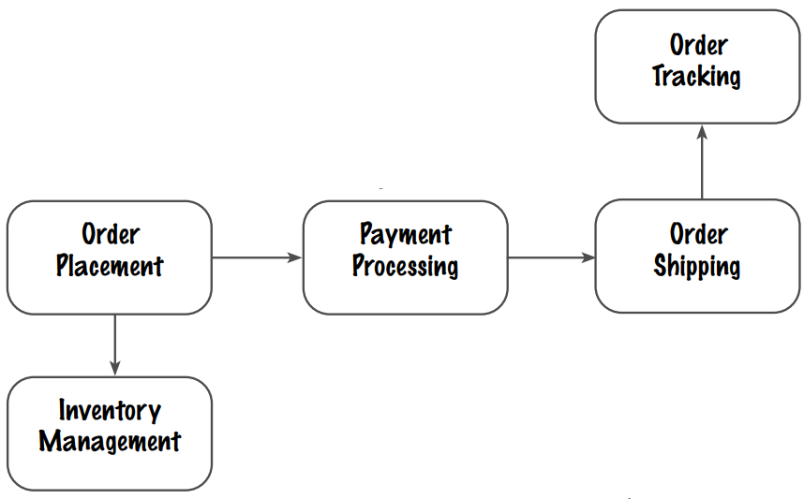
Logical architecture components
The functional building blocks of a system that make up what is known as the problem domain and how they interact with each other

Slide 18
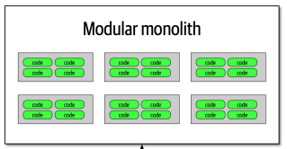
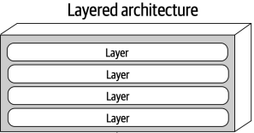
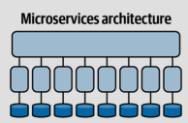
Logical architecture components
These components are combined to form an architecture
Which architecture?
It depends on set of architecture characteristics that is critical to system success

Slide 19
Limit characteristics to prevent overengineering
Applications can only support a few of the architecture characteristics because:
Each of the supported characteristics requires design effort and perhaps structural support
Each architecture characteristic often has an impact on others, for example security and performance
If an architect wants to improve security, it will almost certainly negatively impact performance: the application must do more on-the-fly encryption, indirection for secrets hiding, and other activities that potentially degrade performance

Slide 20
Trade-Offs and Least Worst Architecture
Choices exist for architecture:
architects’ decisions come down to trade-offs between several competing concerns and
architects should strive to design architecture to be as iterative as possible (Agile process) to get the least worst set of trade-off

Slide 21
Reference
Fundamentals of Software Architecture: An Engineering Approach. Mark Richards and Neal Ford (2020): O’REILLY
Chapter 4

